Slide 1


TRACK 1
AMD AI PREMIER LEAGUE
vs
ALGEBRA
Team
TEAM ID 26

Slide 2
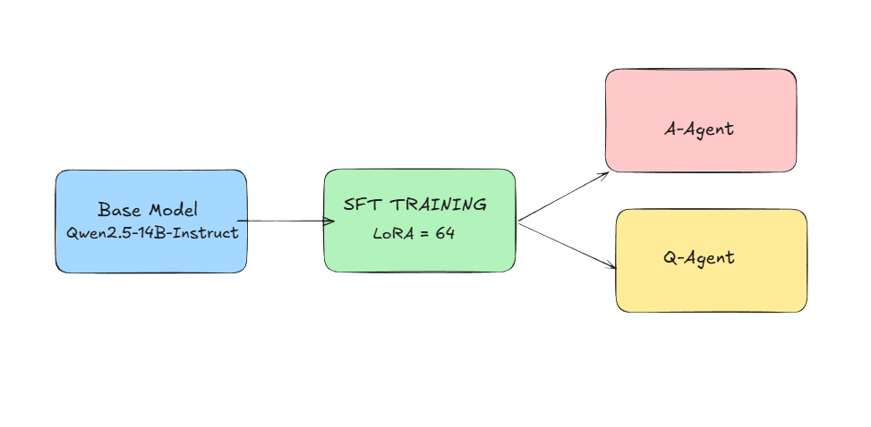
ARCHITECTURE OVERVIEW
Training Pipeline:
Supervised Fine-Tuning (SFT): Learn task format, domain knowledge & quality outputs
LoRA Adaptation: Memory-efficient training on large model

Slide 3
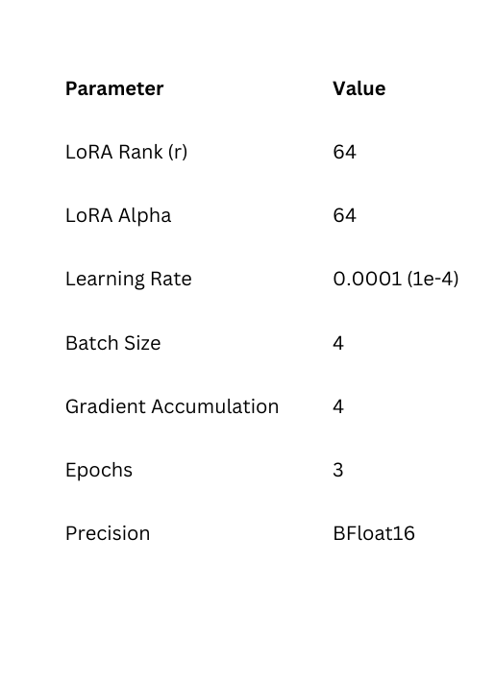
SUPERVISED FINE-TUNING (SFT)
Method: LoRA (Low-Rank Adaptation)
Why LoRA?
Memory efficient, trains only ~0.1% of parameters
Target Modules: q_proj, k_proj, v_proj, o_proj, gate_proj, up_proj, down_proj
Training Strategy
Trained on Responses Only
Chat Template
Data Format

Slide 4
DATA PREPARATION
Dataset Structure
Format: ShareGPT conversation structure
Samples: ~900 curated examples
Split: Training set with held-out validation
Topics Covered
Syllogisms
Seating Arrangements (Linear, Circular)
Family Tree / Blood Relations
Mixed Series (Alphanumeric)
Output Format
{
"topic": "Syllogisms",
"question": "Statement I: All cats are mammals...",
"choices": ["A) Only I follows", "B) Only II follows", "C) Both follow", "D) Neither follows"],
"answer": "B",
"explanation": "Using Venn diagram analysis..."
}

Slide 5
RESULTS & EVALUATION
Model Outputs
Q-Agent: Generates well-structured MCQs with valid JSON format
A-Agent: Provides answers with step-by-step reasoning
Quality Metrics
Valid JSON output rate
Correct answer format (A/B/C/D)
Reasoning quality in explanations
Topic relevance and accuracy

Slide 6
THANK YOU
vs
MD KAIF IMTEYAZ
NAJEEB AHMAD
JAMIA HAMDARD
JAMIA HAMDARD
ANURAG SINGH BHANDARI
DHRUV NIRMAL
JSS ATE
IIT MADRAS

